Slide 1
DRIVING BEHAVIOUR BASED VEHICLE INSURANCE
Group Name: Haizz so many assignmentsss

Slide 2





First target customers
200,000 registered e-hailing drivers in Malaysia

Slide 3
WHY
E-hailing drivers must turn on their smart phone while working.
All smart phone have the accelerometer for the measurement of the driving behaviour.
There is no any insurance company offer vehicle insurance for e-hailing driver.
Because the risk for e-hailing driver to involve in accident is too high and insurance company cant offer a suitable insurance package for all driver.

Slide 4
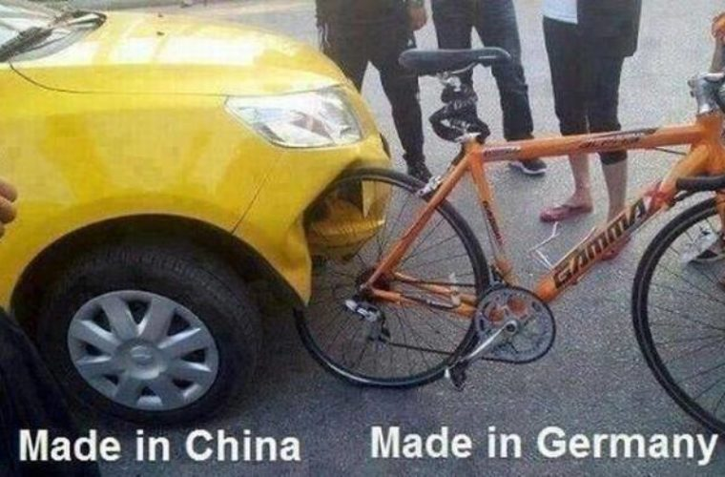

Slide 5


Slide 6
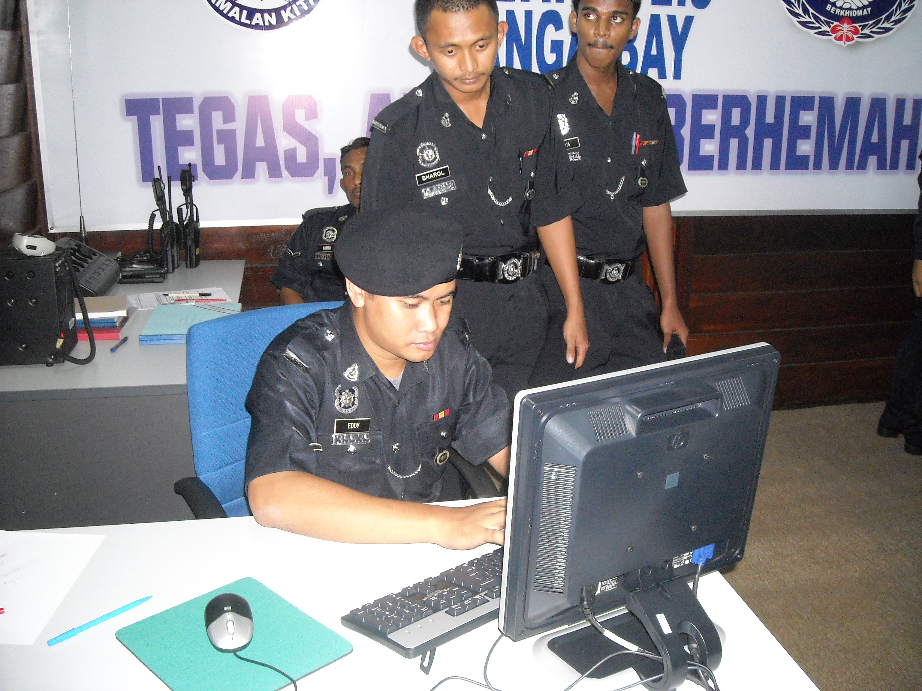

Slide 7
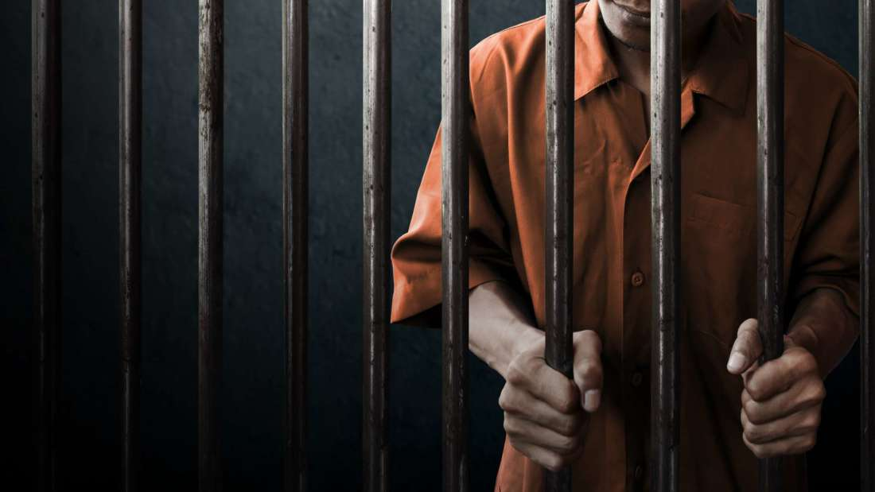

Slide 8
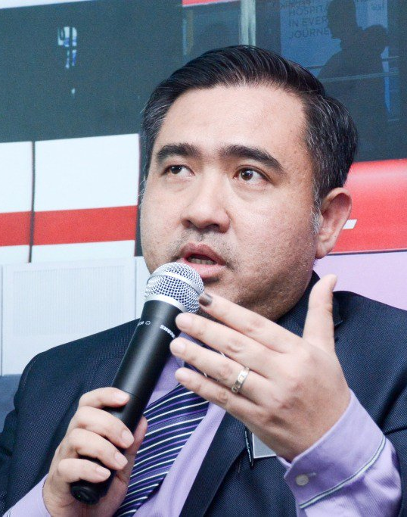
Our Transport Minister, Anthony Loke said e-hailing services and taxi companies must provide insurance coverage for drivers, vehicles, passengers and third parties in 2019.

Slide 9
DRIVING BEHAVIOUR BASED VEHICLE INSURANCE
Calculate insurance price based on driving behaviour and driving distance.
Benefits both part time drivers and full time drivers.

Slide 10
WHY BLOCKCHAIN
Greater transparency
Enhanced security
Build up customer trust towards the insurance company as there is no way for insurance company to modify the data once it uploaded to blockchain.

Slide 11
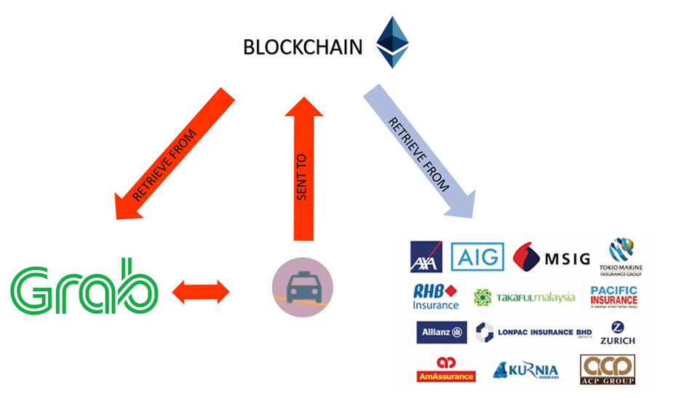

Slide 12


Slide 13
